Slide 1

Statistics For Data Analysis
NTI
Data Analysis

Slide 2











Agenda
Title
1
What IS Statistics? & Why To Learn It?
2
Data Types
3
Data Description

Slide 3






WHAT IS STATISTICS?
Title
Statistics are numbers that summarize raw facts and figures in some meaningful way
Head first statistics

Slide 4

WHY TO LEARN STATISTICS?
Title
Understanding what’s really going on with statistics empowers you:
You’ll be able to make objective decisions.
Make accurate predictions that seem inspired.
Convey the message you want in the most effective way possible

Slide 5

Agenda
Title
1
What IS Statistics? & Why To Learn It?
2
Data Types
3
Data Description

Slide 6

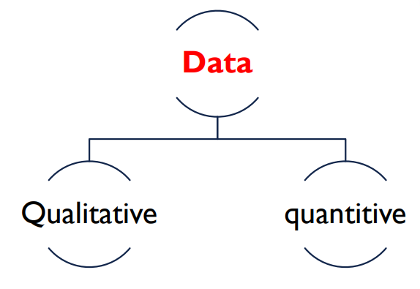
DATA TYPES
Title

Slide 7
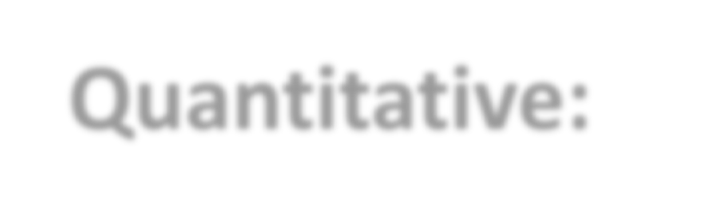
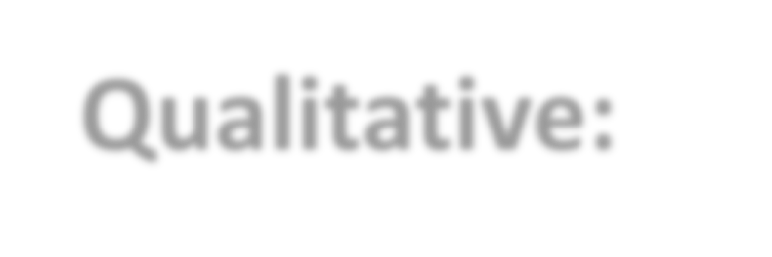
DATA TYPES
Quantitative:
Takes on numeric values that allow us to perform mathematical operations.
can be counted or measured.
Answers questions such as “How many?”, “How often?” or “How much?”
Temperature, weight, and a count of transactions are all quantitative data.
Analysts also refer to this type as Numerical Data.
Qualitative:
The information represents characteristics that you do not measure with numbers. Taste, eye, color, architectural style, and marital status are all types of qualitative variables.
Title

Slide 8

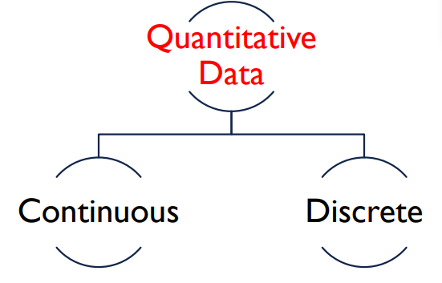
TYPE OF QUANTITATIVE DATA
Title

Slide 9
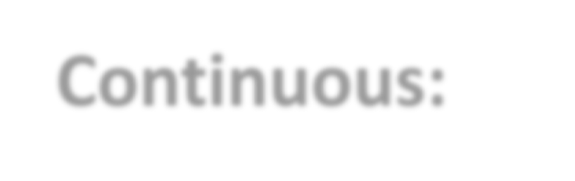

TYPE OF QUANTITATIVE DATA
Continuous:
These variables can take any value within a range, including decimal parts.
EX:
Title
Weight
Height
Temperature
Discrete:
These variables whose values are countable with no intermediate values and can not be subdivided into parts.
EX:
The number of people in a class. ➢ The number of children someone has.

Slide 10

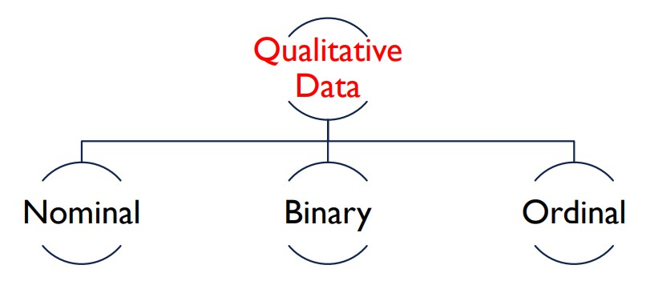
TYPE OF QUALITATIVE DATA
Title

Slide 11


TYPE OF QUALITATIVE DATA
NOMINAL:
Has no intrinsic ordering to its categories.
EX:
Title
Hair color ( Brown – Blonde – Black )
ORDINAL:
Has a clear ordering.
Nationality ( American – German – Kenyan – Japanese )
EX:
Income ( Low – medium – high )
Education level (Primary – Secondary – Post-Secondary )

Slide 12


Agenda
Title
1
What IS Statistics? & Why To Learn It?
2
Data Types
3
Data Description

Slide 13

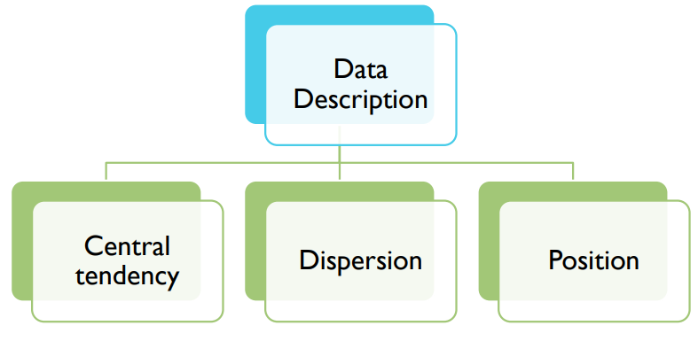
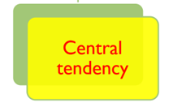
Title

Slide 14
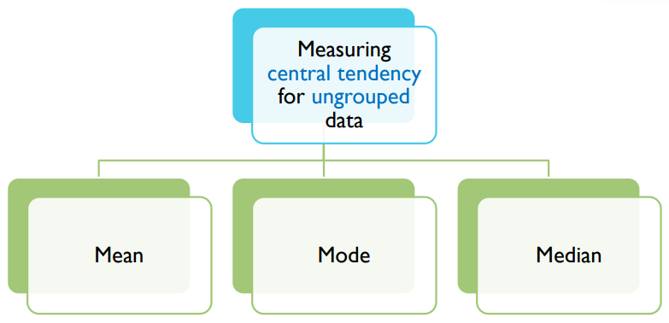
CENTRAL TENDENCY
Title

Slide 15

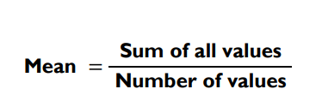
MEAN
Title
It is the average of the given numbers .
is calculated by adding all the numbers together, and then divide by how many numbers there are.
The symbol of mean is μ, this is the Greek let er mu (pronounced “mew”).

Slide 16
MEAN
Example1 :
Have a look at calculating the mean age, Here are The ages:
Title
Age | 19 | 20 | 21
Frequency | 1 | 3 | 1
How many people there are of each age

Slide 17
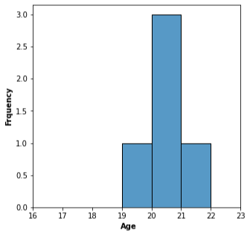
MEAN
Solution:
add all the people’s ages
divide by how many there are.
This gives us:
Title
μ = (19 + 20 + 20 + 20 + 21) / 5 = 20
Note that there are 3 people of age 20.

Slide 18

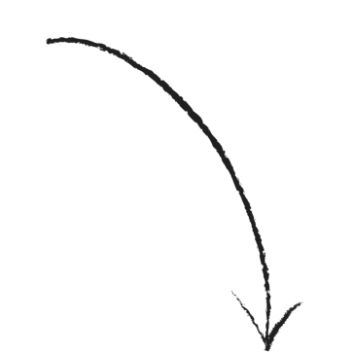
MEAN
Example2 :
Have a go at calculating the mean age, Here are The ages:
Title
Age | 19 | 20 | 21 | 100 | 108
Frequency | 3 | 6 | 3 | 1 | 1
Sometimes a data set may contain a few very small or a few very large values. Such values are called outliers or extreme values.
Solution:
μ = (3× 19 + 6× 20 + 3× 21+ 108+ 100) / 14= 32
The mean is 32, but nobody in the class is around that age. Is it really representative of the
class?

Slide 19

MEAN
Title
Can you see how the outliers have pulled the mean higher?
This effect is caused by outliers in the data. When this happens, we say the data is skewed.

Slide 20
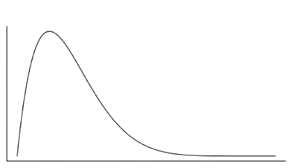
MEAN
Title
Right-Skewed (Positively):
A positively skewed distribution is the distribution with the tail on its right side.

Slide 21
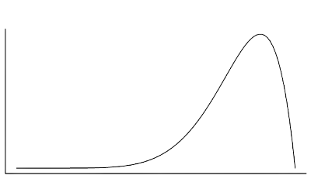
MEAN
Title
Left-Skewed (negatively):
A negatively skewed distribution is the distribution with the tail on its left side

Slide 22
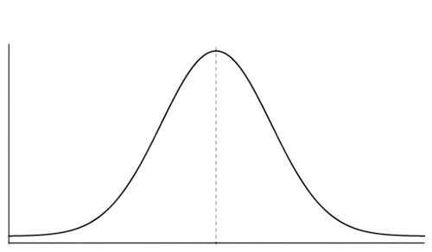
MEAN
Symmetric:
A symmetric distribution is a distribution with balanced left and right tails
Title

Slide 23


So, how are we gonna find the average?
Title

Slide 24
MEDIAN
Title
Is the average of the given numbers .
To find the median:
Line up all the ages in ascending order
Then pick the middle value, like this:
19 19 19 20 20 20 20 20 20 21 21 21 100
Here, the number in the middle represents the median, 20

Slide 25
MEDIAN
What if there had been an even number of people in the class?
19 19 19 20 20 20 20 20 20 21 21 21 100 108
Title
If there’s an even number of people in the class, there will be no single middle number.
just take the mean of the two middle numbers (add them together, and divide by 2), and that’s your median.
In this case, the median is 20.

Slide 26
MEDIAN
What if there had been an even number of people in the class?
19 19 19 20 20 20 20 20 20 21 21 21 100 108
Title
If there’s an even number of people in the class, there will be no single middle number.
The mean of this data set is 32, While the median is 20.
This means that the median fixed the outliers problem.

Slide 27
MEDIAN
How to find the median in three steps:
Line your numbers up in order, from smallest to largest.
If you have an odd number of values, the median is the one in the middle. If you have n numbers, the middle number is at position (n + 1) / 2.
If you have an even number of values, get the median by adding the two middle ones together and dividing by 2.
You can find the midpoint by calculating (n + 1) / 2. The two middle numbers are on either side of this point.
Title

Slide 28

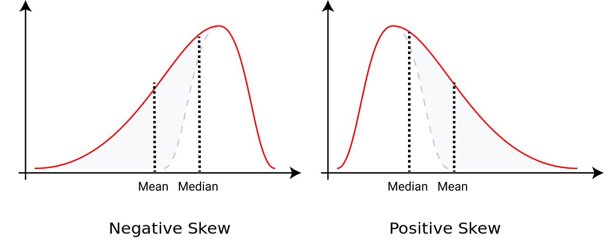
RELATIONSHIP AMONG MEAN & MEDIAN
Title

Slide 29
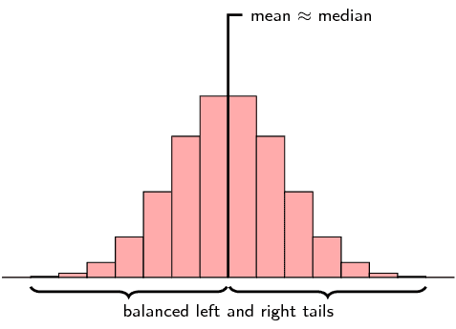
RELATIONSHIP AMONG MEAN & MEDIAN
Title

Slide 30
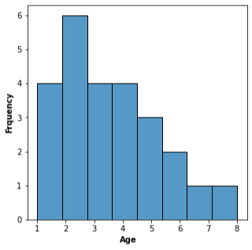
MEDIAN
Example1 :
Have a go at calculating the median of the coming data set
Title
Age | 1 | 2 | 3 | 4 | 5 | 6 | 7 | 8
Frequency | 4 | 6 | 4 | 4 | 3 | 2 | 1 | 1
25 values
Solution:
Median position= (25+1) / 2 = 13
The median is 3.
μ = (4 ×1 + 2×6 + 4×3 + 4×4 + 3×5 + 2×6 + 1×7 + 1×8) / 25 = 3.44
The mean is higher than the median, The data Right-Skewed

Slide 31
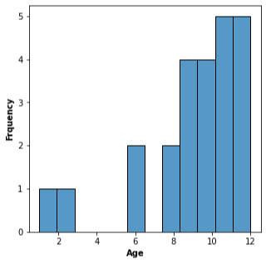
MEDIAN
Example2 :
Have a go at calculating the median of the coming data set
Title
Age | 1 | 2 | 6 | 8 | 9 | 10 | 11 | 12
Frequency | 1 | 1 | 2 | 2 | 4 | 4 | 5 | 5
24 values
Solution:
(24+1) / 2 = 12.5
The two middle points are at positions 12, 13
The median is 10.
μ = (1×1 + 2×1 + 6×2 + 8×2 + 9×4 + 10×4 + 11×5 + 12×5) / 24 = 9.25
The mean is lower than the median, The data Left-Skewed

Slide 32
MEDIAN
Example3 :
Find the mean and median of the coming dataset
Title
Age | 1 | 2 | 3 | 31 | 32 | 33
Frequency | 3 | 4 | 2 | 2 | 4 | 3
18 values
Solution:
The median is 17.
μ = 17
The mean is equal to the median, The data Symmetric

Slide 33
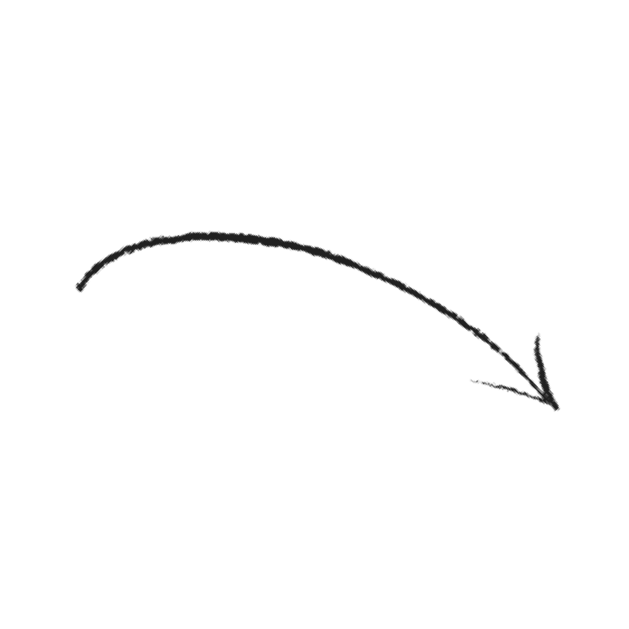
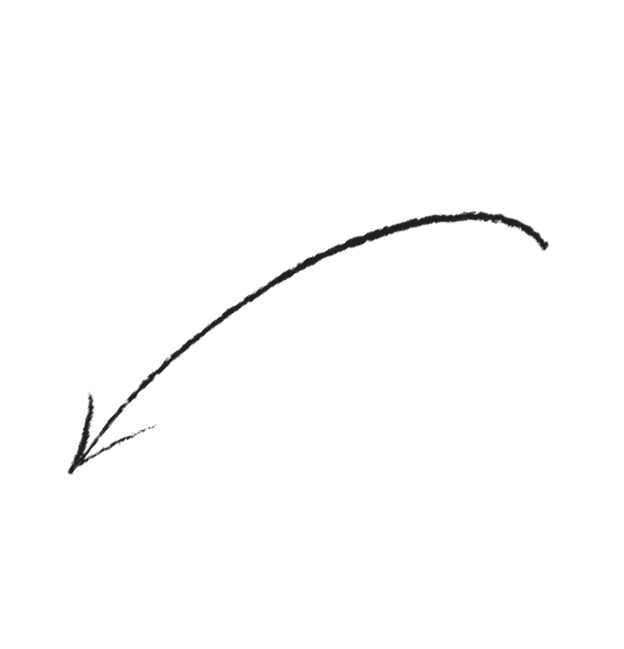
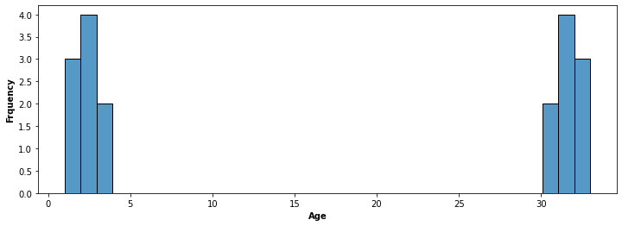
MEDIAN
Title
One group of
data here
Another group
of data here
The Mean and median are here

Slide 34


What if you could pick two ages instead?
Title
Age | 1 | 2 | 3 | 31 | 32 | 33
Frequency | 3 | 4 | 2 | 2 | 4 | 3

Slide 35
MODE
Title
The third type of average.
The mode of is the value with the highest frequency in the data set.
It can be calculated for both kinds of data: quantitative and qualitative-whereas the mean and median can be calculated for only quantitative data.
So it’s the only sort of average that works with categorical data.

Slide 36
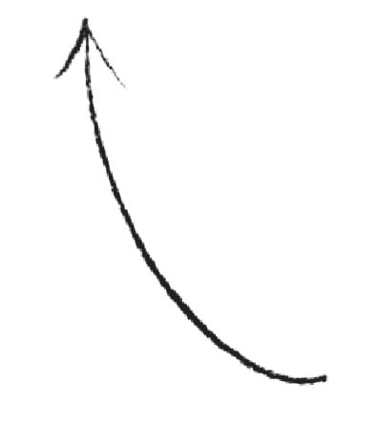
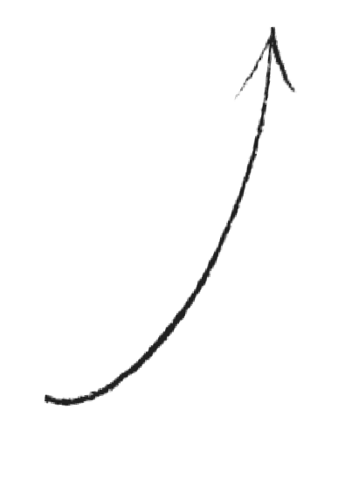
MODE
In the previous example, the dataset was bimodal
Title
Age | 1 | 2 | 3 | 31 | 32 | 33
Frequency | 3 | 4 | 2 | 2 | 4 | 3
BIMODAL
These two values are the most popular, so they are both modes.
Ages 2 and 32 have the highest frequency, so these ages are both modes

Slide 37
MODE
Title
Three steps for finding the mode:
Find all the distinct categories or values in your set of data.
Write down the frequency of each value or category.
Pick out the one(s) with the highest frequency to get the mode.

Slide 38
MODE
Example2 :
Find the mode for the following set of data.
Title
Category | Blue | Red | Green | Pink | Yellow
Frequency | 4 | 5 | 8 | 1 | 3
Solution:
This time the mode is Green.
UNIMODAL

Slide 39
MODE
Example3 :
Find the mode for the following set of data.
Title
Age | 1 | 2 | 3 | 4 | 5 | 6 | 7 | 8
Frequency | 4 | 6 | 4 | 4 | 3 | 2 | 1 | 1
UNIMODAL
Solution:
The mode here is 2, as it has the highest frequency.

Slide 40
MODE
Example3 :
Find the mode for the following set of data.
Title
Category | 1 | 2 | 3 | 4 | 5
Frequency | 2 | 3 | 3 | 3 | 3
Solution:
This set of data has several modes: 2, 3, 4, and 5
The mode is not useful when there are many modes.
MULTIIMODAL

Slide 41

RELATIONSHIP AMONG MEAN & MEDIAN & MODE
Title
The Mean is the most-used measure of central tendency, followed by the median.
The Mean has the advantage that its calculation includes each value of the data set.
The Median is a better measure when a data set includes outliers.
The Mode is simple to locate, but it is not of much use in practical applications

Slide 42
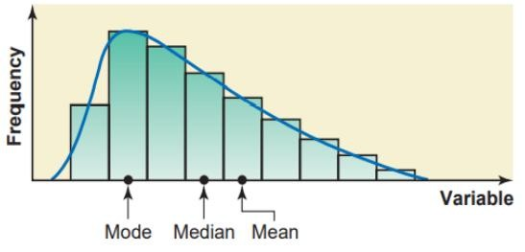
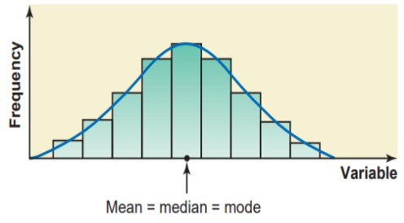
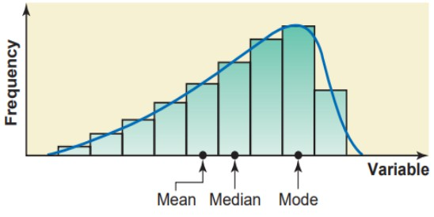
Graphically, the Peak of a Histogram is the mode.
RELATIONSHIP AMONG MEAN & MEDIAN & MODE
Title
POSITIVE SKEW
SYMMETRIC DISTRBUTION
NEGATIVE SKEW

Slide 43
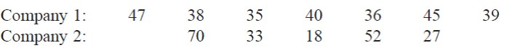
Title
The Mean age of workers in both these companies is the same, 40 years
NO Mode (Data is no-modal )
Medan is not expressed

Slide 44



The measures of central tendency, such as the mean, median, and mode, are usually not a sufficient measure to reveal the whole picture of the distribution of a data set.
Title
We need a measure that can provide some information about the variation among data values and help us learn about the spread of a data!

Slide 45
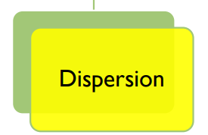
Title

Slide 46
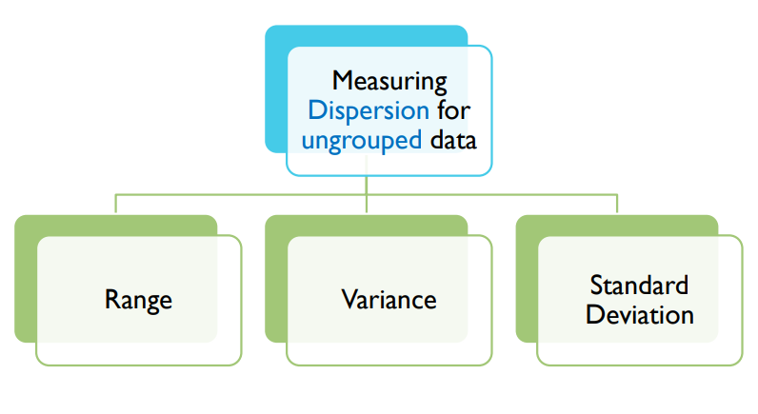
Title

Slide 47


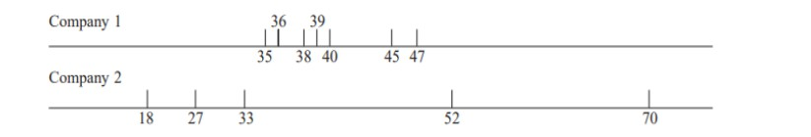
RANGE
Title
The ages of the workers at the second company have a much larger variation than the ages of the workers at the first company.
Company 1= 47-35 =12
Company 2= 70-18 =52

Slide 48
RANGE
Title
The Range is the simplest measure of dispersion to calculate
Range = Largest value − Smallest value
The following table gives the total areas in square miles of the four western South-Central states of the United States. Find the range for this data set.
Range = Largest value − Smallest value
= 267.277- 49.651 = 217.626 square miles
State | Arkansas | Louisiana | Oklahoma | Texas
Total Area (square miles) | 53.182 | 49.651 | 69.903 | 267.277

Slide 49
RANGE
Title
The range, like the mean, has the disadvantage of being sensitive to Outliers.
Another disadvantage of using the range is that its calculation is based on two values only: the largest and the smallest: All other values in a data set are ignored when calculating the range.
Thus, the range is not a very satisfactory measure of dispersion

Slide 50

DEVIATION
The most common measures of variability
Subtracting from each observation (X).
We now consider how to combine the deviations into a single numerical measure of variability.
A first thought might be to calculate the average deviation.
This does not work, though, because negative and positive deviations counteract one another in the summation.
Title

Slide 51


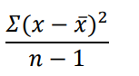
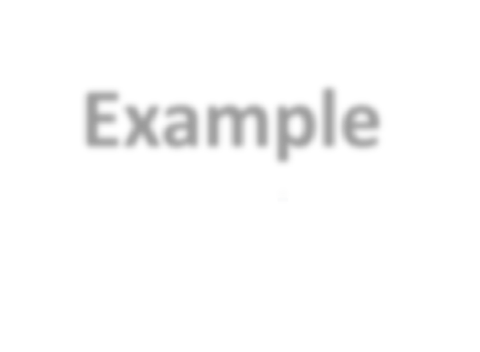
VARIANCE
Title
The basic formulas that are used to calculate the variance :
The quantity in the above formula is called the deviation of the 𝑥 value from the mean.
Example
Suppose the midterm scores of four students are 1,2,3,4,5, respectively. Then, Calculate the variance.

Slide 52


STANDARD DEVIATION
Title
The standard deviation is the most-used measure of dispersion.
It’s obtained by taking the positive square root of the variance.
The value of the standard deviation tells how closely the values of a data set are clustered around the mean.
In general, a lower value of the standard deviation for a data set indicates that the values of that data set are spread over a relatively smaller range around the mean.
In contrast, a larger value of the standard deviation for a data set indicates that the values of that data set are spread over a relatively larger range around the mean.

Slide 53


STANDARD DEVIATION & VARIANCE
Title
The values of the variance and the standard deviation are never negative.
Usually the values of the variance and standard deviation are positive, but if a data set has no variation, then the variance and standard deviation are both zero.

Slide 54
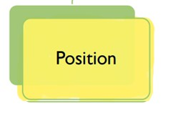
Title

Slide 55

POSITION
Title
A measure of position determines the position of a single value in relation to other values. There are many measures of position; however, only quartiles is discussed in this section.

Slide 56


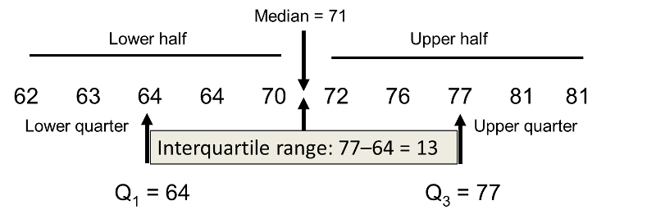
QUARTILES & INTERQUARTLE RANGE
Title
Quartiles are the summary measures that divide a ranked data set into four equal parts. Three measures will divide any data set into four equal parts. These three measures are the first quartile (denoted by 𝑄1 ), the second quartile (denoted by 𝑄2 ), and the third quartile (denoted by 𝑄3. The data should be ranked in increasing order before the quartiles are determined .

Slide 57
QUARTILES & INTERQUARTLE RANGE
Title
Quartiles are the summary measures that divide a ranked data set into four equal parts. Three measures will divide any data set into four equal parts. These three measures are the first quartile (denoted by 𝑄1 ), the second quartile (denoted by 𝑄2 ), and the third quartile (denoted by 𝑄3. The data should be ranked in increasing order before the quartiles are determined .
Calculating Interquartile Range
The difference between the third and the first quartiles gives the interquartile range; that is,
IQR = Interquartile range = 𝑄3 − 𝑄1

Slide 58
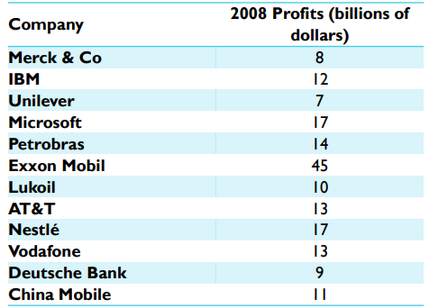
QUARTILES & INTERQUARTLE RANGE
For the following table which gives the 2008 profits (rounded to billions of dollars) of 12 companies selected from all over the world.
(a) Find the values of the three quartiles.
(b) Where does the 2008 profits of Merck & Co fall in relation to these quartiles?
(c) Find the interquartile range
Title

Slide 59
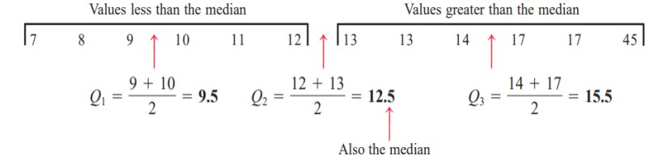
QUARTILES & INTERQUARTLE RANGE
Title
(a)
(b)
By looking at the position of $8 billion, which is the 2008 profit of Merck & Co, we can state that this value lies in the bottom 𝟐𝟓% of the profits for 2008 .
(c)
IQR = Interquartile range = 𝑄3 − 𝑄1 = 15.5 − 9.5 = $𝟔 billion

Slide 60


BOX -AND-WHISKER PLOT
Title
A plot that shows the center, spread, and skewness of a data set. It is constructed by drawing a box and two whiskers that use the median, the first quartile, the third quartile, and the smallest and the largest values in the data set between the lower and the upper inner fence

Slide 61
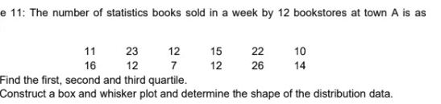
BOX -AND-WHISKER PLOT
Title
Example
Median
𝑄1
𝑄3
IQR
1.5 × IQR = 1.5 × 24 = 36
Lower inner fence = 𝑄1 -
Upper inner fence = 𝑄3 +
Determine the smallest and the largest values in the given data set within the two inner fences.

Slide 62
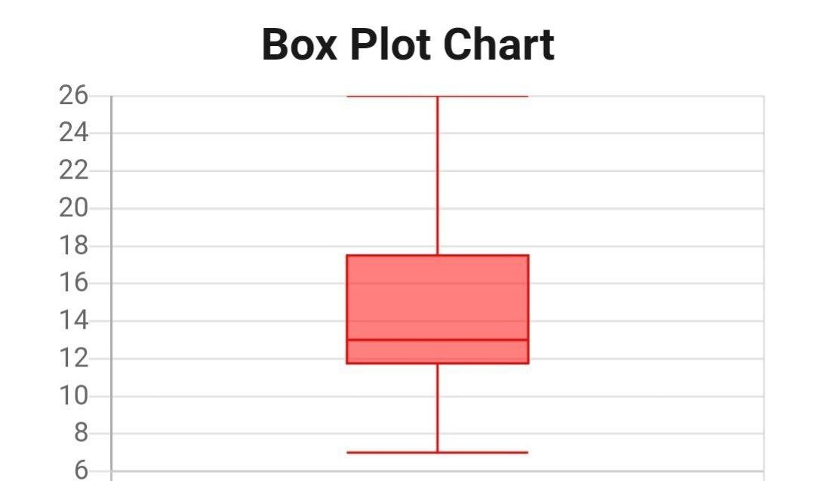
BOX -AND-WHISKER PLOT
Title

Slide 63
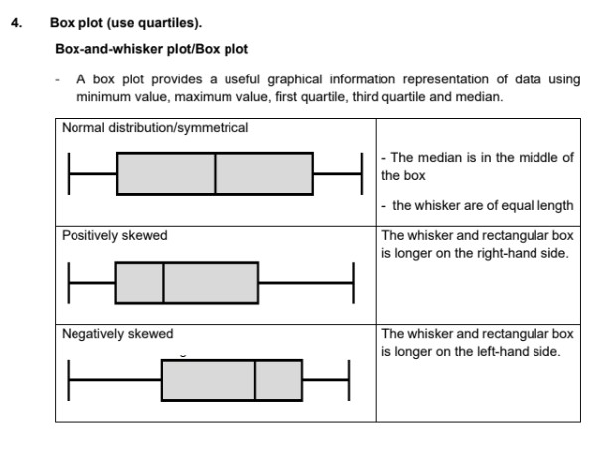
BOX -AND-WHISKER PLOT
Title

Slide 64
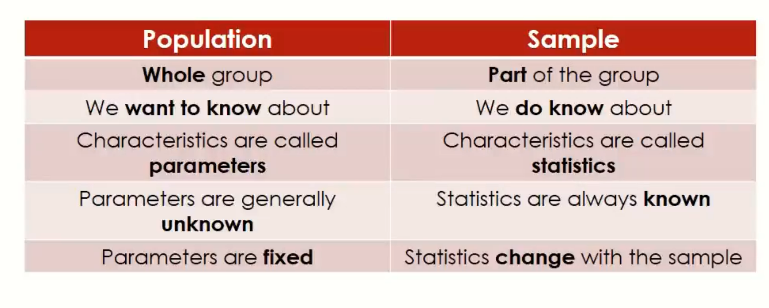
Population Vs. Sample
Title

Slide 65

1- Descriptive Statistics
Data Types (Categorical and Numerical)
Measures Of Center
Histograms
Measures Of Spread and Five number Summary
Standard Deviation and Variance
Distribution Shapes
Outliers
Normal Distribution Theory

Slide 66
Data Types
Main Type | Subtype | Description | Examples
Categorical | Nominal | Categories with no inherent order. | Gender, Color, Country
 | Ordinal | Categories with a meaningful order but no fixed intervals between them. | Education Level (High School, Bachelor, Master), Rank (1st, 2nd, 3rd)
Numerical | Discrete | Countable numbers with no intermediate values. | Number of children, Number of cars
 | Continuous | Measurable quantities with infinite possible values within a range. | Height, Weight, Temperature

Slide 67

Measures of Center
Measures of center are statistical tools used to summarize a set of data by identifying the central point within that data set.
The three primary measures of center are the Mean, Median, and Mode.

Slide 68
Measures of Center
Measure | Description | Calculation | Sensitivity to Outliers | Example
Mean | The average of all data points. | Sum of all values divided by the number of values. | Highly sensitive; outliers can significantly affect the mean. | For data set {1, 2, 3, 4, 100}, mean = (1+2+3+4+100)/5 = 22
Median | The middle value when data points are ordered. | The middle value of an ordered data set. If even number of values, the average of the two middle values. | Less sensitive; median is not affected by outliers as much. | For data set {1, 2, 3, 4, 100}, median = 3
Mode | The most frequently occurring value(s). | The value(s) that appear most often in the data set. | Not affected by outliers. | For data set {1, 2, 2, 3, 100}, mode = 2

Slide 69
Histograms
A histogram is a graphical representation of the distribution of a dataset.
It is used to depict the frequencies of data points within specified ranges (bins) and helps in understanding the shape, spread, and central tendency of the data.

Slide 70
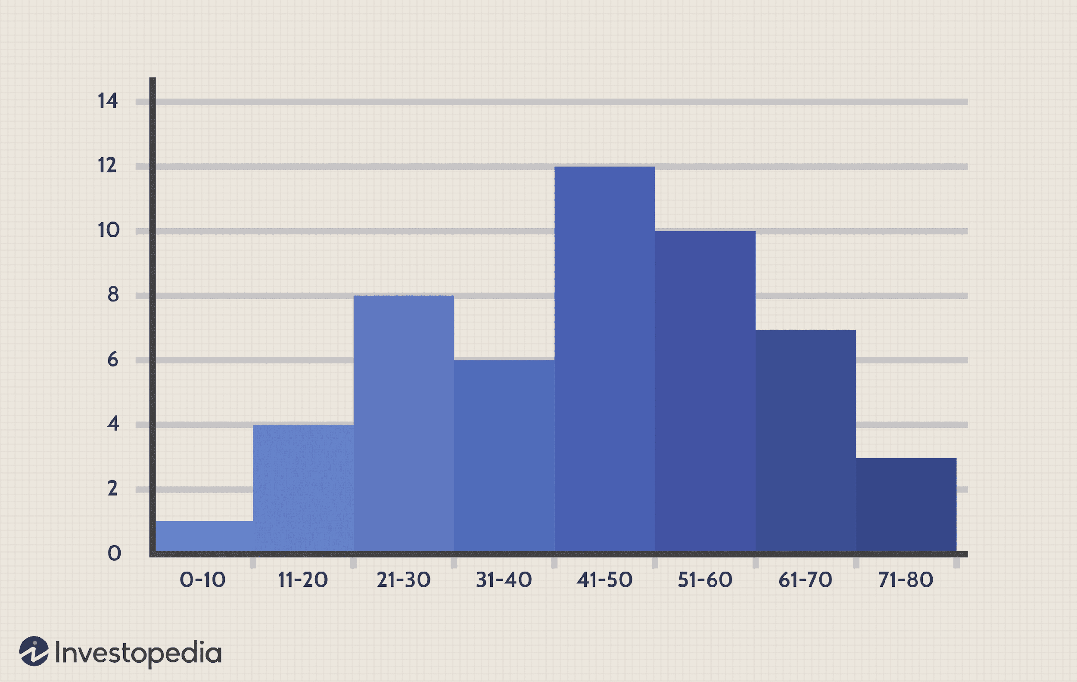
Histograms

Slide 71
Measures of Spread
Measures of spread provide insights into the variability and distribution of a data set.
The five-number summary is a concise description of a data set that includes: Minimum, Q1, Q2, Q3, and Maximum

Slide 72
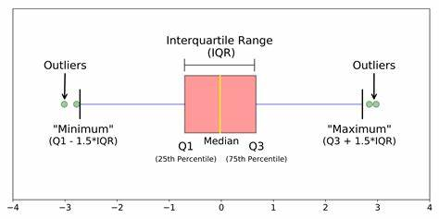
Measures of Spread

Slide 73
Standard Deviation and Variance
Measure | Description | Calculation | Example with Data Set {1, 2, 3, 4, 100}
Range | Difference between max and min values. | Max value - Min value | Range = 99
Variance | Average of squared differences from mean. | (Sum of squared differences from mean) / (n-1) | Variance ≈ 1922.5
Standard Deviation | Square root of the variance. | √ Variance | Standard Deviation ≈ 43.84
IQR | Difference between Q3 and Q1. | Q3 - Q1 | IQR = 2

Slide 74

Standard Deviation and Variance
Why Do We Divide by (n-1) in the Variance?
Why Do We Need Both Variance and Standard Deviation?

Slide 75
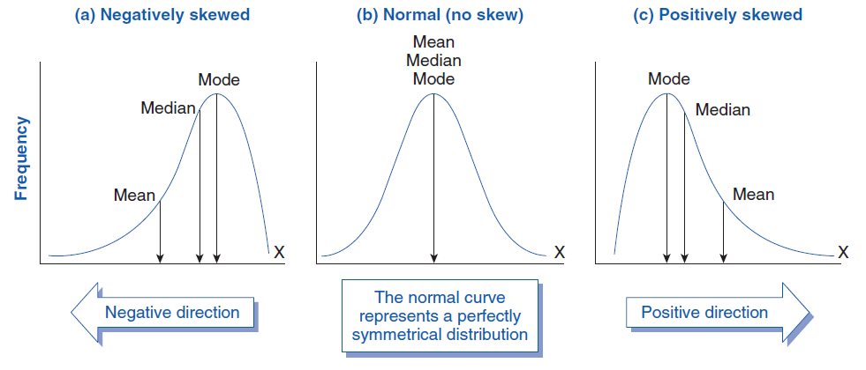
Distribution Shapes

Slide 76
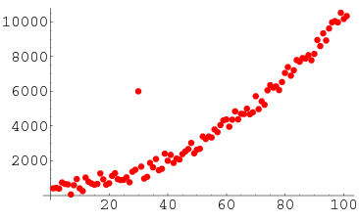
Outliers

Slide 77
Handling Outliers
Method | Appropriate When | Example | Advantages | Disadvantages
Remove Outliers | Outliers are errors or irrelevant to analysis | Removing erroneous data entry (e.g., age = 200) | Simple and effective | Risk of losing valuable data
Cap and Floor | Outliers are extreme but valid data points | Capping salaries above 99th percentile | Reduces impact of extreme values | Can distort data distribution
Transformation | Data is highly skewed | Applying log transformation to income data | Normalizes data, reduces skewness | May complicate interpretation
Imputation | Outliers are few and not critical | Replacing outliers with median value | Maintains dataset size | Introduces bias, may mask true variability
Model-Based Methods | Robust models are required for analysis | Using robust regression (e.g., RANSAC) | Handles outliers effectively in modeling | More complex, requires specialized methods
Clustering | Identifying outliers as noise in clustering | DBSCAN algorithm identifying outlier points in spatial data | Identifies natural groupings, handles noise | Computationally intensive

Slide 78
Recap & Exercise

Slide 79
2- Inferential Statistics
Sampling Distribution
Confidence intervals
Hypothesis Testing
Case Study (A/B Testing)
Regression
Advanced Topics

Slide 80
Sampling
Sampling is a process used in statistics to select a subset (sample) of individuals, items, or data points from a larger population.
The purpose of sampling is to make inferences or generalizations about the population based on the analysis of the sample.

Slide 81
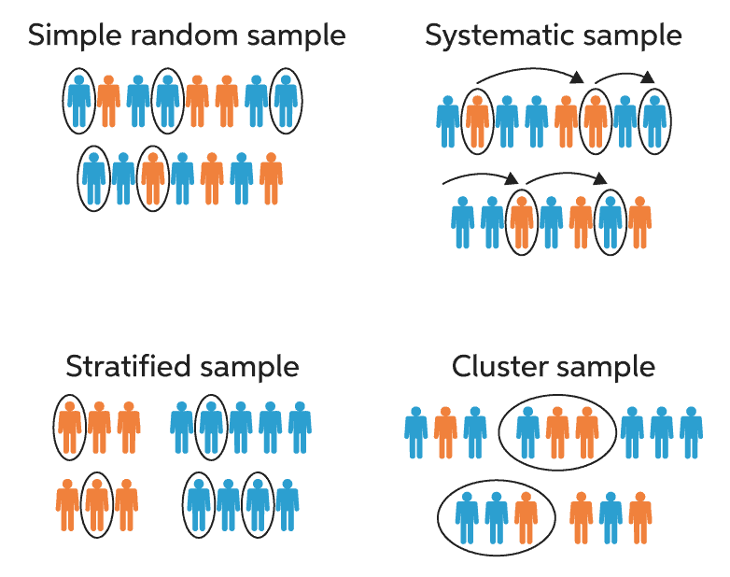
Sample Types

Slide 82
Sampling Key Concepts
Aspect | Population | Sample
Definition | The entire group of interest | A subset of the population
Statistical Measures | Parameters (population mean μ, population variance σ2) | Statistics (sample mean xˉ, sample variance s2)

Slide 83
Sampling Distribution
The sampling distribution is centered on the original parameter value.
The sampling distribution decreases its variance depending on the sample size used.

Slide 84
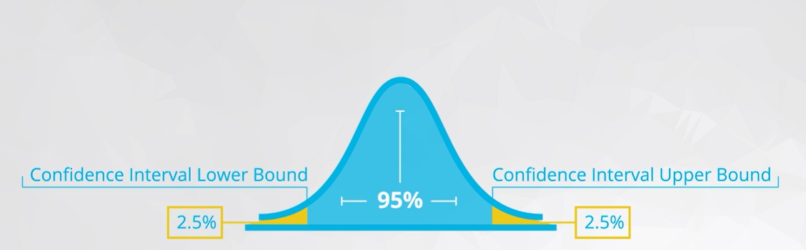
Confidence Intervals

Slide 85
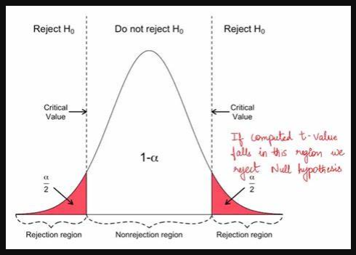
Hypothesis Testing

Slide 86
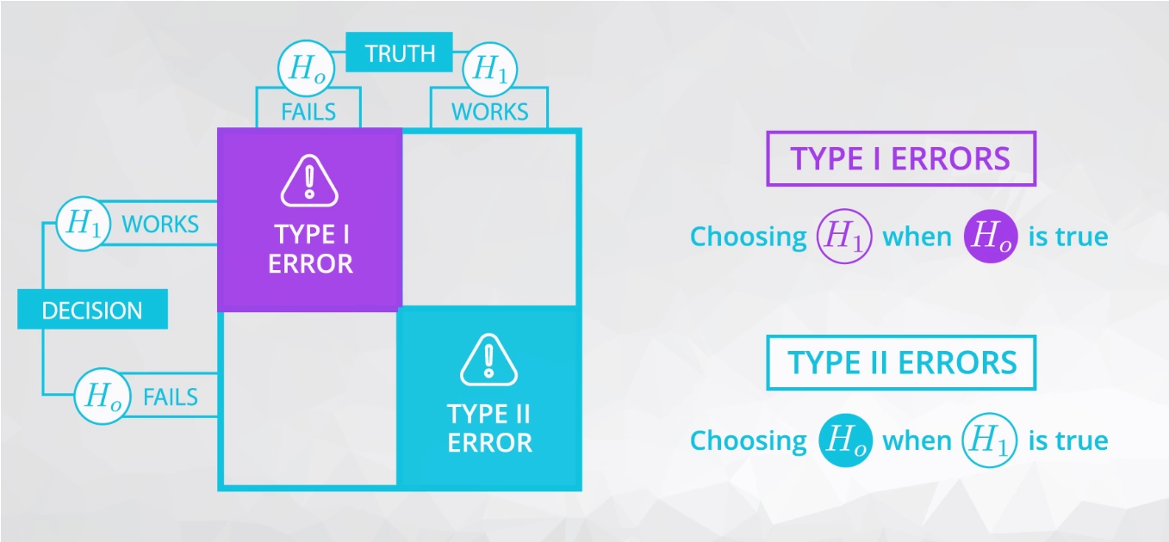
Types Of Errors

Slide 87
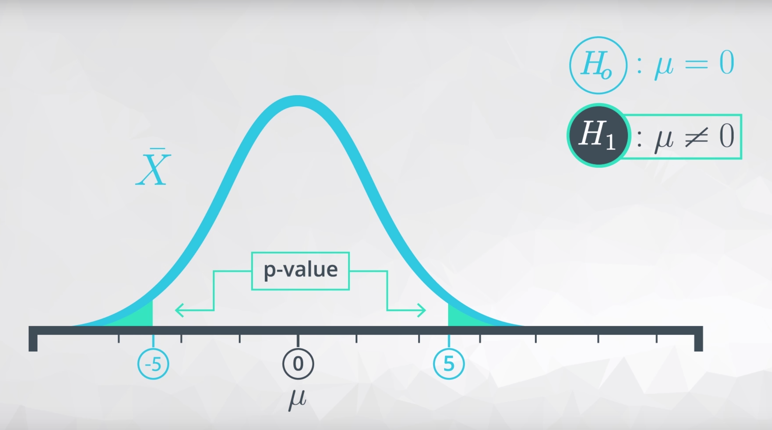
P-Value

Slide 88
P-Value
The probability of obtaining a test statistic at least as extreme as the one observed, assuming the null hypothesis is true.
A low p-value (typically ≤ 0.05) indicates strong evidence against the null hypothesis, suggesting it may be rejected.
P-values help determine the significance of results in hypothesis testing.
They do not measure the probability that the null hypothesis is true or false.

Slide 89
P-Value Cases

Slide 90

Case Study (A/B Testing)

Slide 91

Introduction To Regression

Slide 92
Regression
Modeling and Analyzing the relationship between a dependent variable and one or more independent variables.
Regression seeks to find the best-fitting line through the data points.
The resulting equation can be used to predict values of the dependent variable based on new values of the independent variables.

Slide 93

Example:

Slide 94

Questions

Slide 95
Thank You.
NTI
Ola El-Shiekh
Data Analysis
01021183564
ola.elshiekh71@gmail.com
https://www.linkedin.com/in/ola-el-shiekh/

